Slide 1


Innovative aspects of the Companion Volume: concepts in depth
CEFR Companion Volume implementation toolbox
Boîte à outils pour la mise en œuvre du volume complémentaire du CECR
© 2023. This work is licensed under an Attribution-NonCommercial-ShareAlike International Creative Commons CC-BY-NC-SA 4.0 License. Attribution: Original activity from Fischer Johann (et al.) (2023), CEFR Companion Volume implementation toolbox, Council of Europe (European Centre for Modern Languages), Graz, available at www.ecml.at/companionvolumetoolbox.

Slide 2
Innovative aspects of the CEFR Companion Volume
The action-oriented approach and the notion of the social agent
The four modes of communication
Interaction: Online interaction
Mediation
Pluricultural aspects
Plurilingual approaches
→ Paradigm shift
Constructive alignment

Slide 3
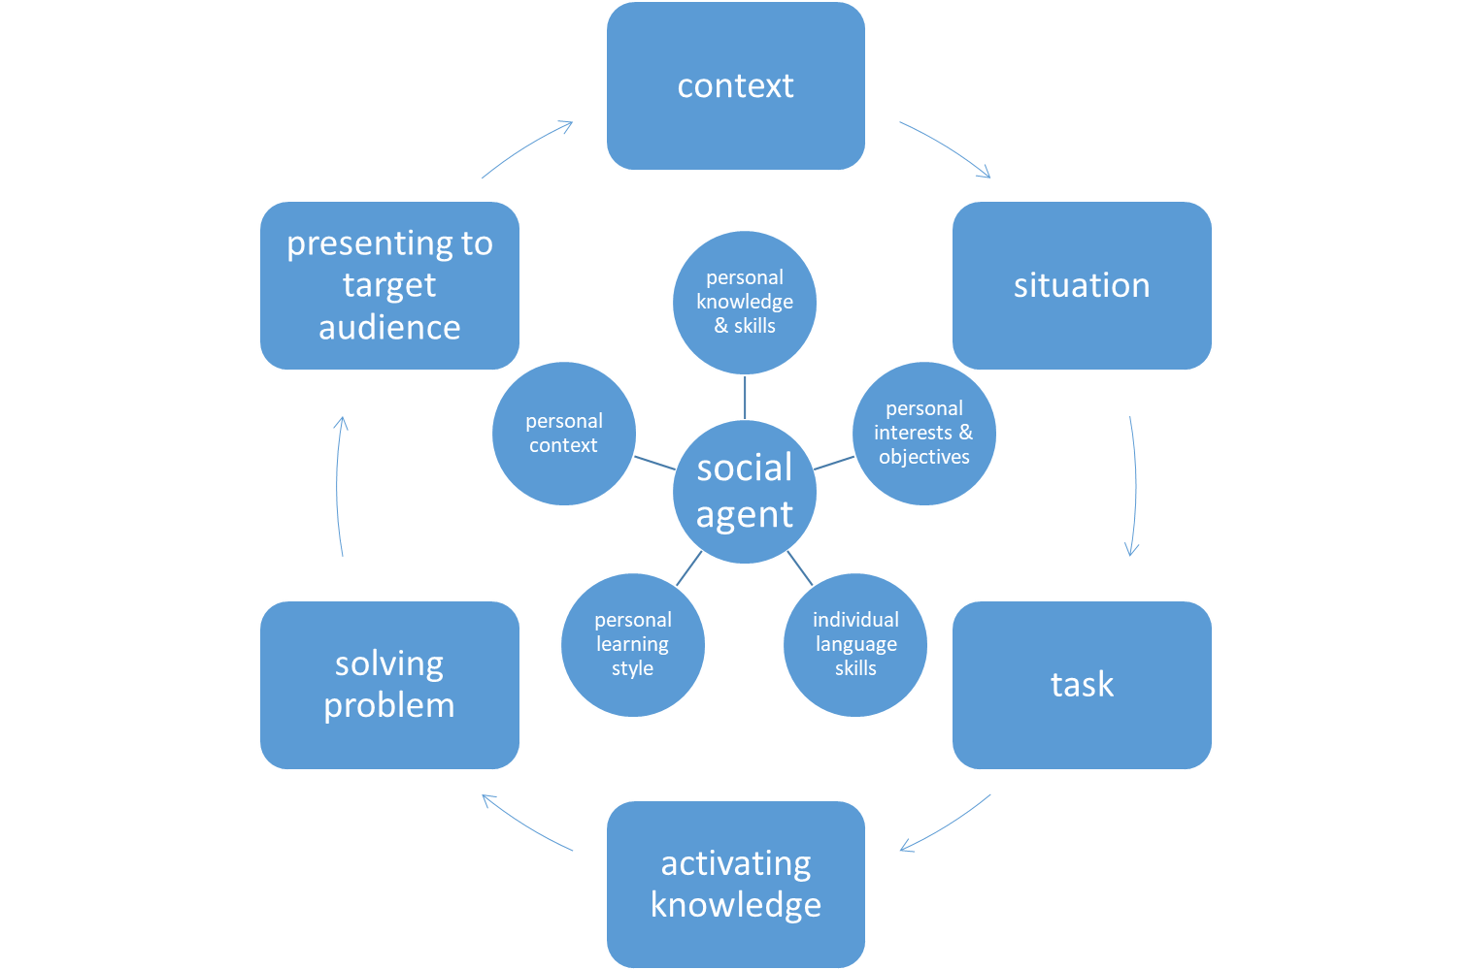
The action-oriented approach and the notion of the social agent
action-oriented approach: not a new concept, but highlighted in the theoretical part of the publication
focus on the learner as a social agent
emphasis on collaborative tasks and
co-construction of meaning
See: VITbox module “Action-oriented approach & social agent”, and also: Fischer (2021): 254; Fischer / Wolder (2022): 197.

Slide 4
The four modes of communication
The CEFR descriptors have been regrouped according to the four modes of communication they address:
reception
production
interaction
mediation

Slide 5
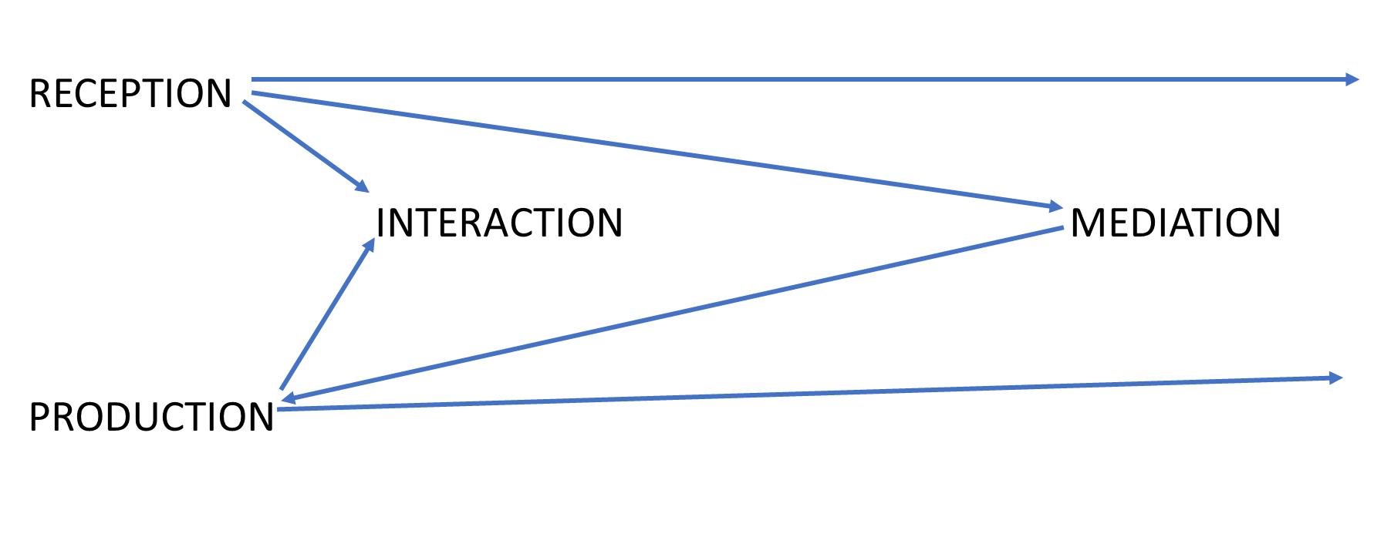
The four modes of communication
Council of Europe (2020): Common European Framework for Languages: Learning, Teaching, Assessment. Companion volume, 34.
https://rm.coe.int/common-european-framework-of-reference-for-languages-learning-teaching/16809ea0d4

Slide 6
The four modes of communication
The four modes of communication focus on the aims of a situation of communication.
They do not replace the four language skills, but provide a different, more target perspective on situation of communication.

Slide 7
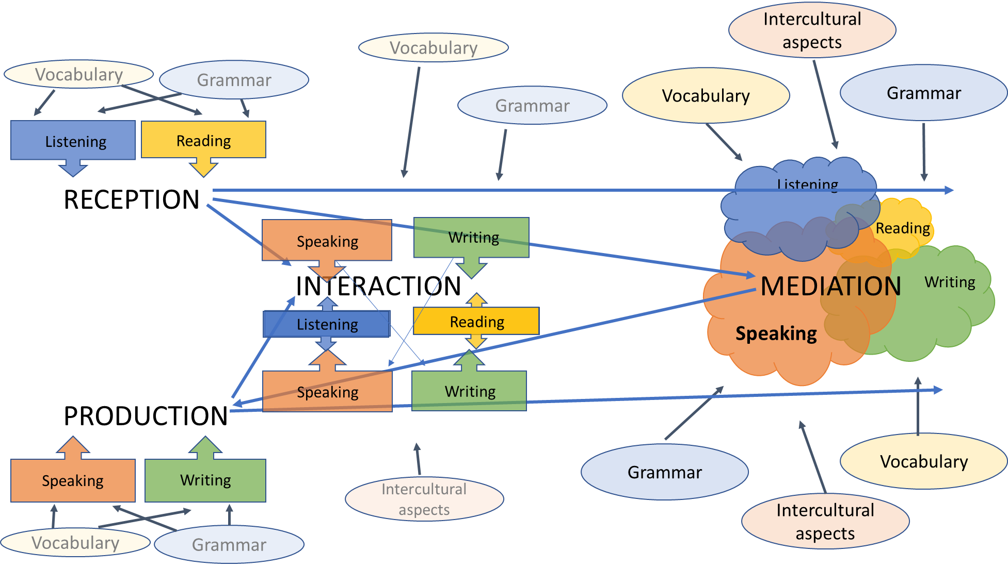
see: VITbox module on four modes of communication, and also: Fischer / Wolder (2021: 14)

Slide 8
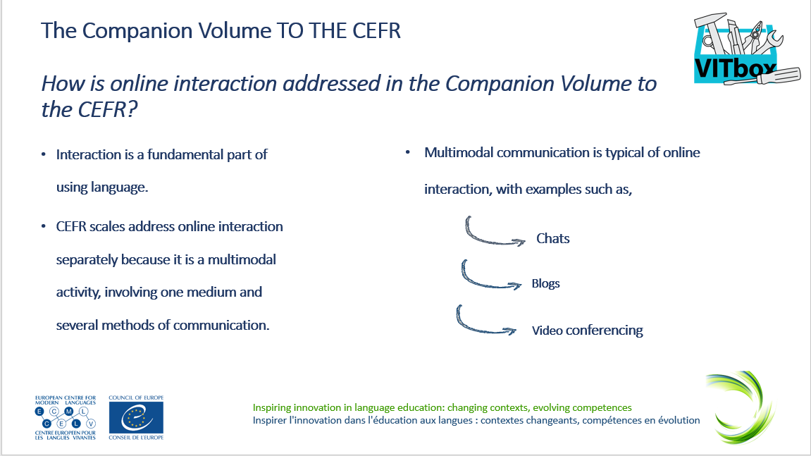
Interaction: Online interaction
taking into account current developments and trends in society
online interaction as a a multimodal activity
for more information please consult the VITbox module on online communication

Slide 9
Mediation
idea of construction of meaning
more than 20 scales on mediation
considerable feedback
larger discussion among language teaching professionals

Slide 10
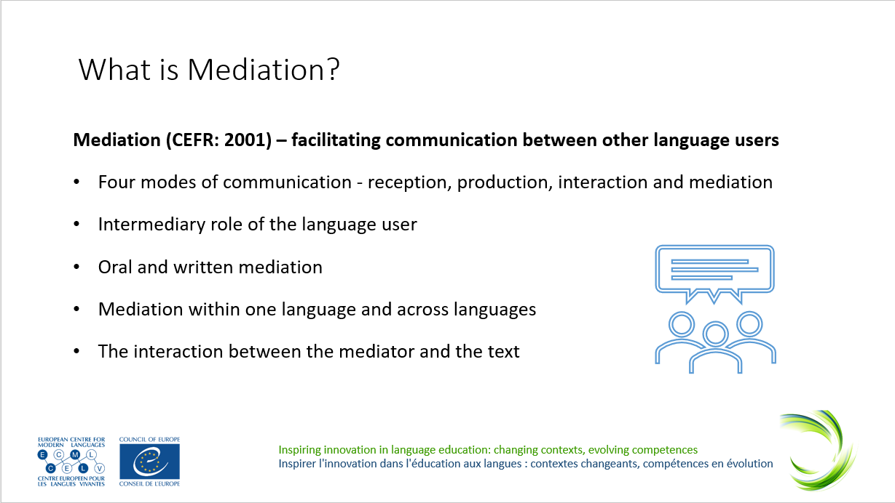
Mediation
Mediation activities
  mediating a text
  mediating concepts
  mediating communication
Mediation strategies
  strategies to explain a new concept
  strategies to simplify a text
see: VITbox module on mediation

Slide 11
Plurilingual approaches
promoting plurilingual approaches
using heritage languages as a useful resource
fostering social inclusion
for more information please consult the VITbox module on plurilingualism

Slide 12
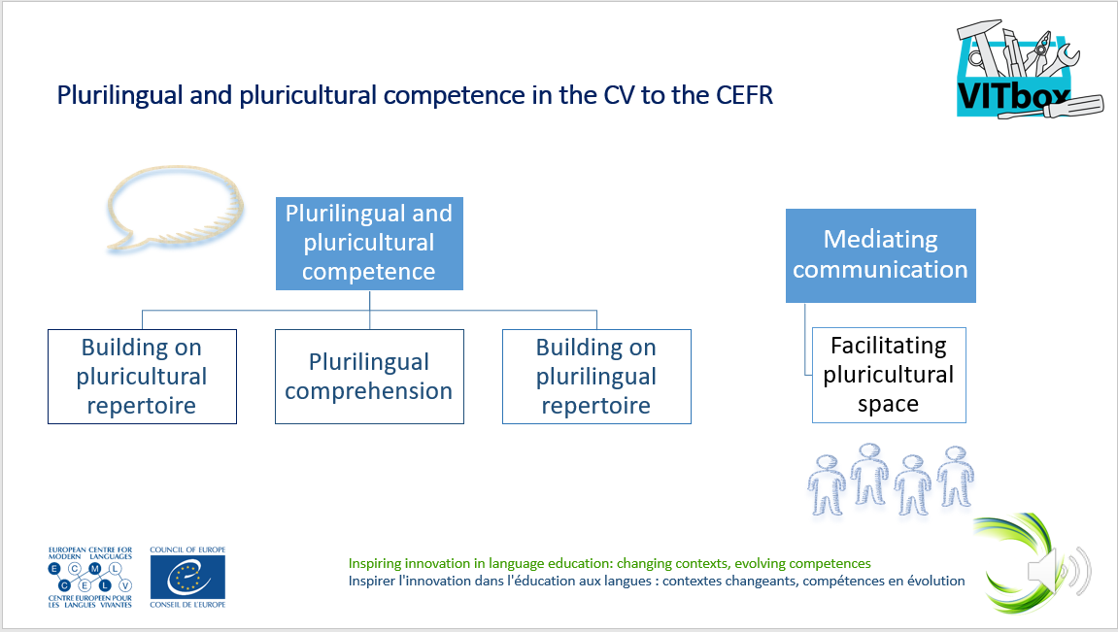
Pluricultural aspects
promoting cultural diversity
encouraging intercultural education, intercultural dialogue, social inclusion
for more information please consult the VITbox module on pluricultural aspects

Slide 13
Paradigm shift
The notion of the “learner as a social agent”
puts learner at the centre of any activity (in teaching, learning and assessment),
gives more autonomy to the learner
who is made responsible for his or her learning (self-reflected learning).
It requires action-oriented and task-based approaches to teaching and
requires to bring in line teaching, learning and assessment (“constructive alignment”).
It also requires a variety of approaches to assessment
and allows the learner to develop individual skills profiles.

Slide 14
Constructive alignment
→ aligning teaching, learning and assessment
This requires:
defining the learning objectives based on the new descriptor scales and descriptors
linking assessment tasks to tasks and projects carried out in the classroom
i.e. making sure that the exam reflects the skills, competences and activities developed in the classroom and addresses the learning objectives
for more information please consult the VITbox module on constructive alignment

Slide 15
The CEFR Companion Volume – References
Council of Europe (2001): Common European Framework of Reference for Languages: Learning, teaching, assessment. Cambridge: CUP.
Council of Europe (2020): Common European Framework of Reference for Languages: Learning, Teaching, Assessment – Companion volume. Strasbourg: Council of Europe Publishing.
Council of Europe CEFR website: https://www.coe.int/en/web/common-european-framework-reference-languages/home
CEFR Descriptors – searchable database: https://rm.coe.int/cefr-descriptors-2020-/16809ed2c7
Fischer, Johann (2021): The Language Learner as a Social Agent – neuer Blick auf die Lernenden dank des Companion Volumes zum GER. In: Brandt, Anikó / Buschmann-Göbels, Astrid / Harsch, Claudia (eds.): Rethinking the Language Learner: Paradigmen – Methoden – Disziplinen. Erträge des 7. Bremer Symposions. Bochum: AKS-Verlag, 246-259.
Fischer, Johann / Wolder, Nicole (2021): Erfahrungen in der Umsetzung der Inhalte des Begleitbands zum GeR im Hochschulkontext – Ergebnisse eines Projektes des Europarates und Handlungsbedarf für Hochschulsprachenzentren. Fremdsprachen und Hochschule 96, 7-27.
Fischer, Johann / Wolder, Nicole (2022): Implementation of the CEFR Companion Volume in the UNIcert® and NULTE Networks. In: North, Brian / Piccardo, Enrica / Goodier, Tim / Fasoglio, Daniela / Margonis-Pasinetti, Rosanna / Rüschoff, Bernd (eds.): Enriching 21st century language education. The CEFR Companion volume in practice, Strasbourg: Council of Europe Publishing, 185-201.

